Slide 1
<AR-VR-VE For Computer Science Education 2.0>
Team Members: <Mairim Barrios, Arelys Alvarez, Samira Tellez, Fidel Hernandez, Carlos Martinez> Product Owner: Dr. Francisco Ortega
Instructor: Masoud Sadjadi School of Computing and Information Sciences Florida International University
Final Presentation
The logo of your project
Notes:
7 seconds.( I will select 2 best slides (i will give them extra points and students will present for CIS committee)
Greet your audience, thank them for attending your presentation, introduce yourself, introduce your project, introduce your team members, and quickly indicate what each of you did in a high-level manner, and put more emphasis on your part/contribution.

Slide 2

Screenshots
Notes:
10 seconds.
Introduce the problem that the whole project (in all versions) tackles with GIF or screenshot.

Slide 3
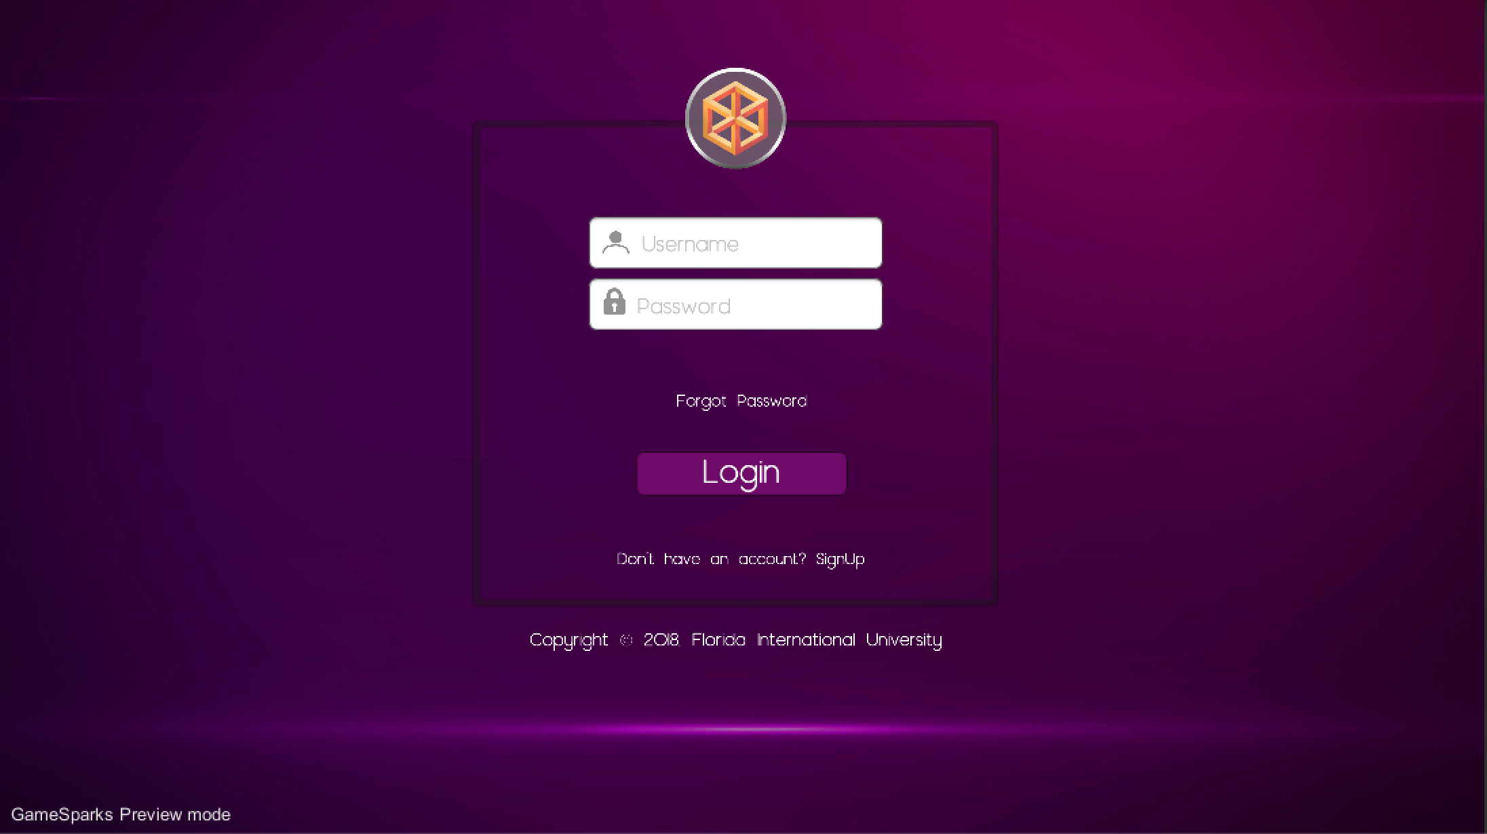
Screenshots
Notes:
10 seconds.
Introduce the problem that the whole project (in all versions) tackles with GIF or screenshot.

Slide 4
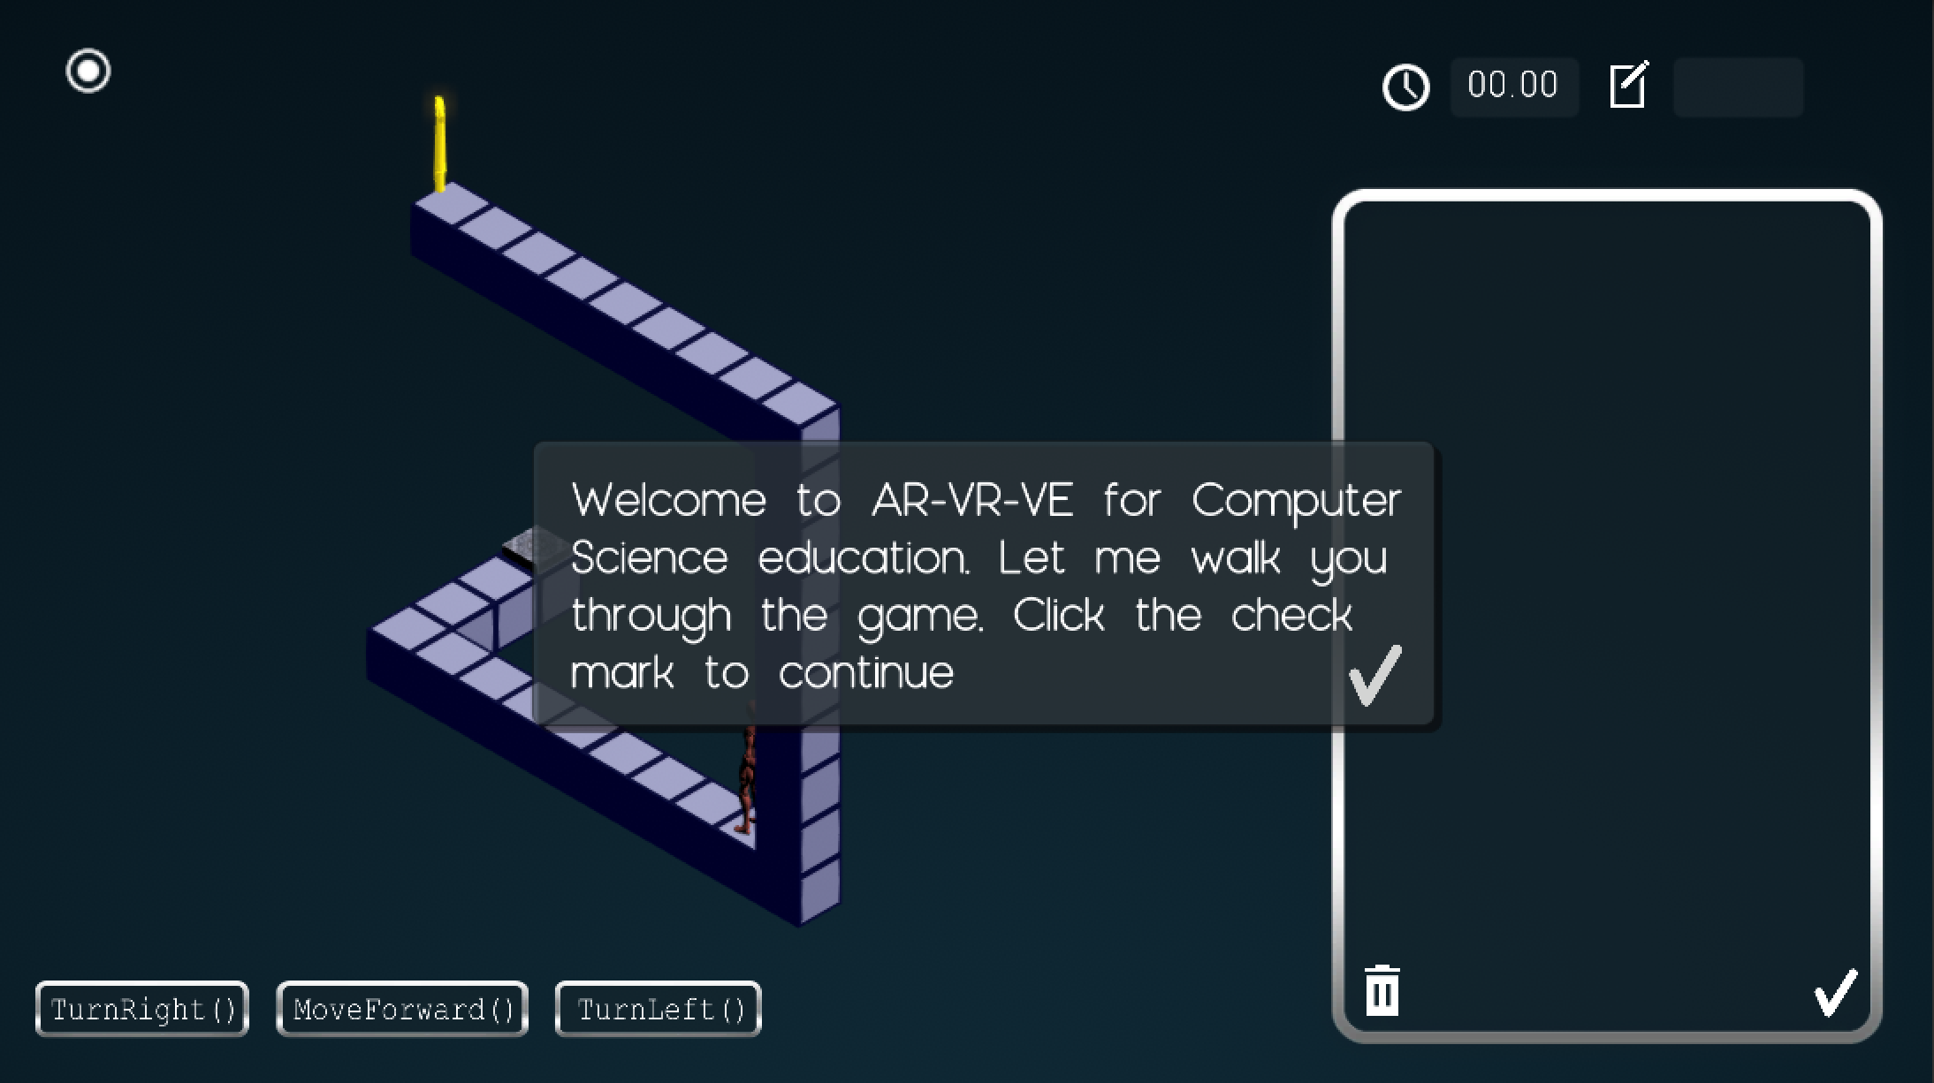
Screenshots
Notes:
10 seconds.
Introduce the problem that the whole project (in all versions) tackles with GIF or screenshot.

Slide 5
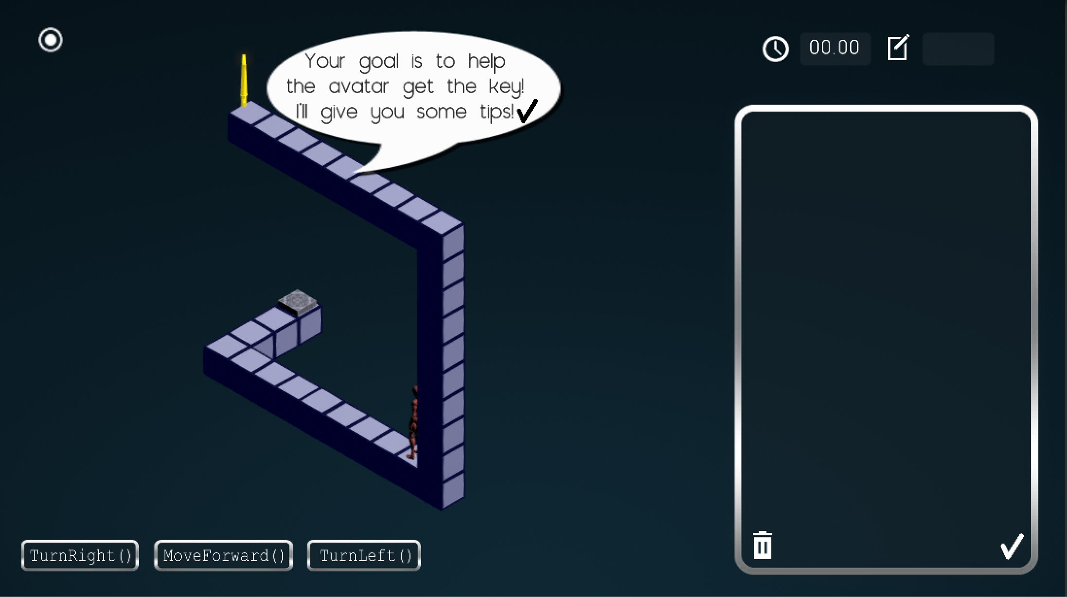
Screenshots
Notes:
10 seconds.
Introduce the problem that the whole project (in all versions) tackles with GIF or screenshot.

Slide 6
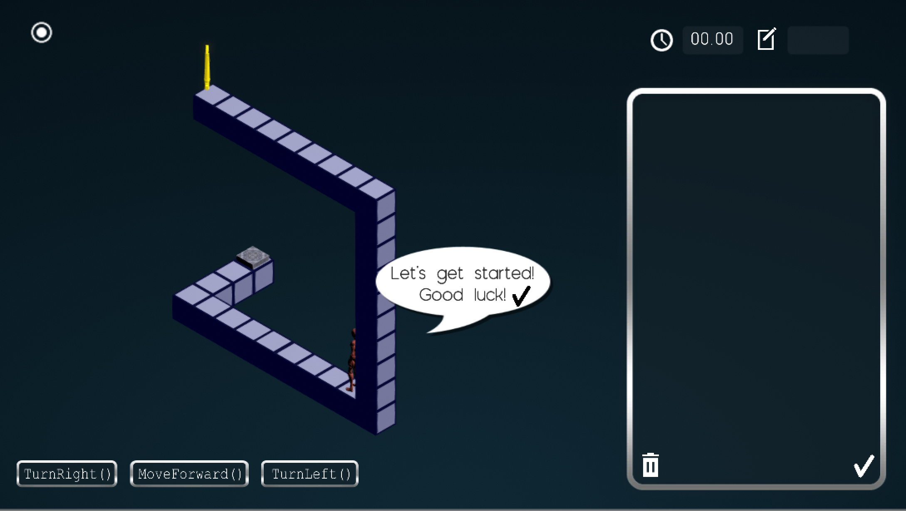
Screenshots
Notes:
10 seconds.
Introduce the problem that the whole project (in all versions) tackles with GIF or screenshot.

Slide 7
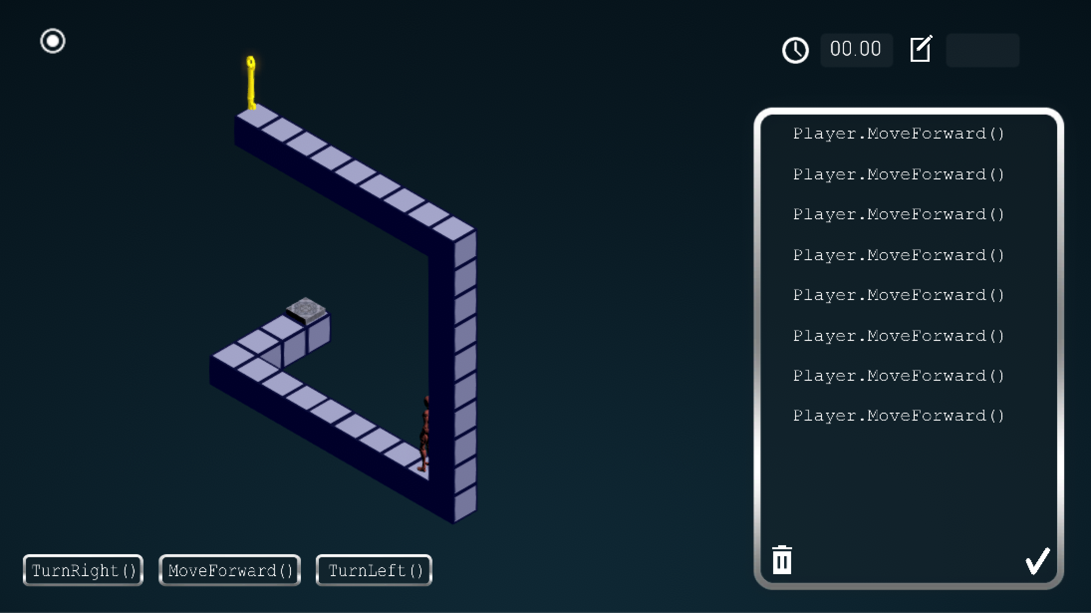
Screenshots
Notes:
10 seconds.
Introduce the problem that the whole project (in all versions) tackles with GIF or screenshot.

Slide 8
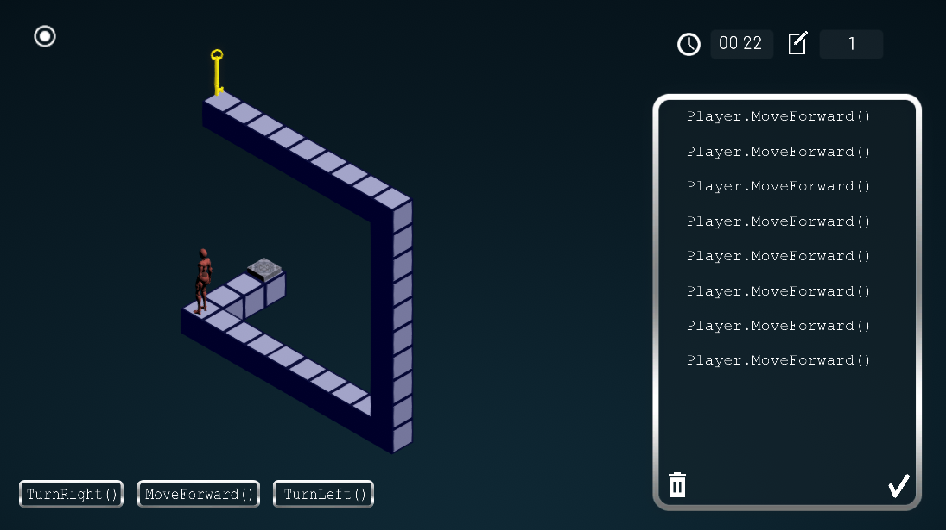
Screenshots
Notes:
10 seconds.
Introduce the problem that the whole project (in all versions) tackles with GIF or screenshot.

Slide 9
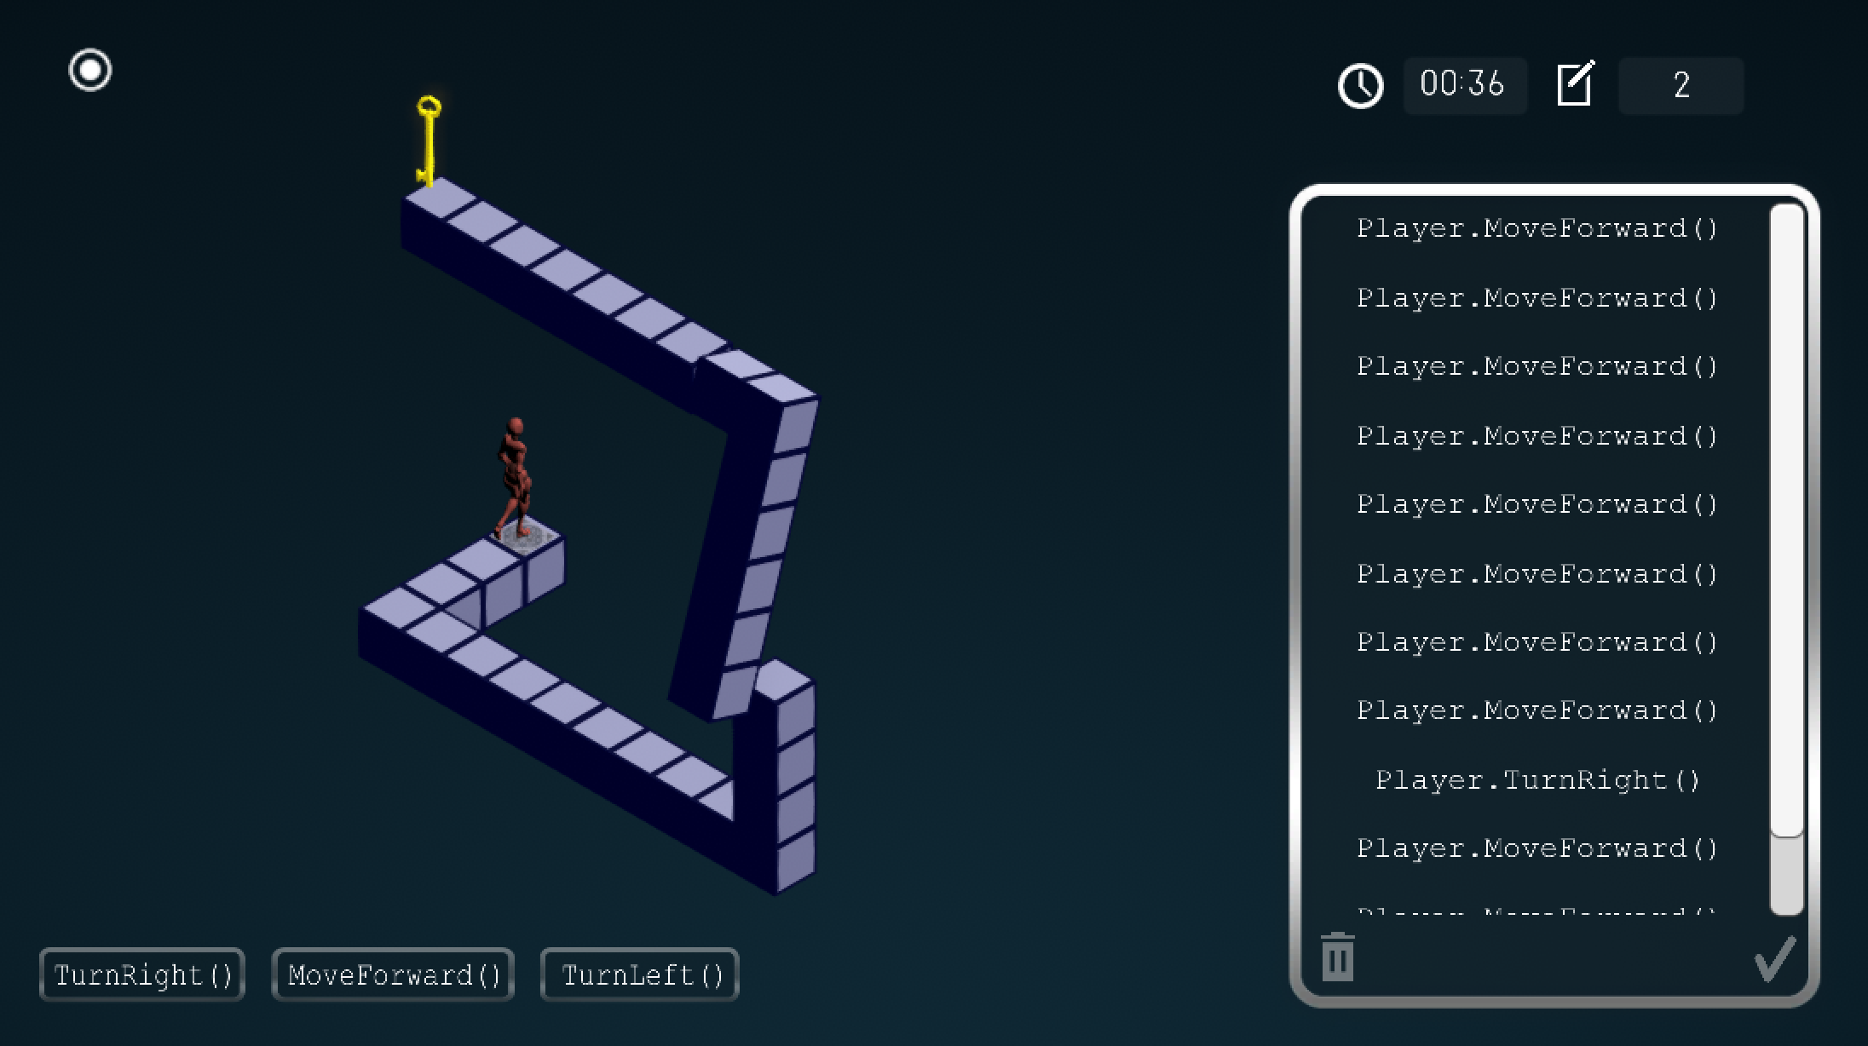
Screenshots
Notes:
10 seconds.
Introduce the problem that the whole project (in all versions) tackles with GIF or screenshot.

Slide 10
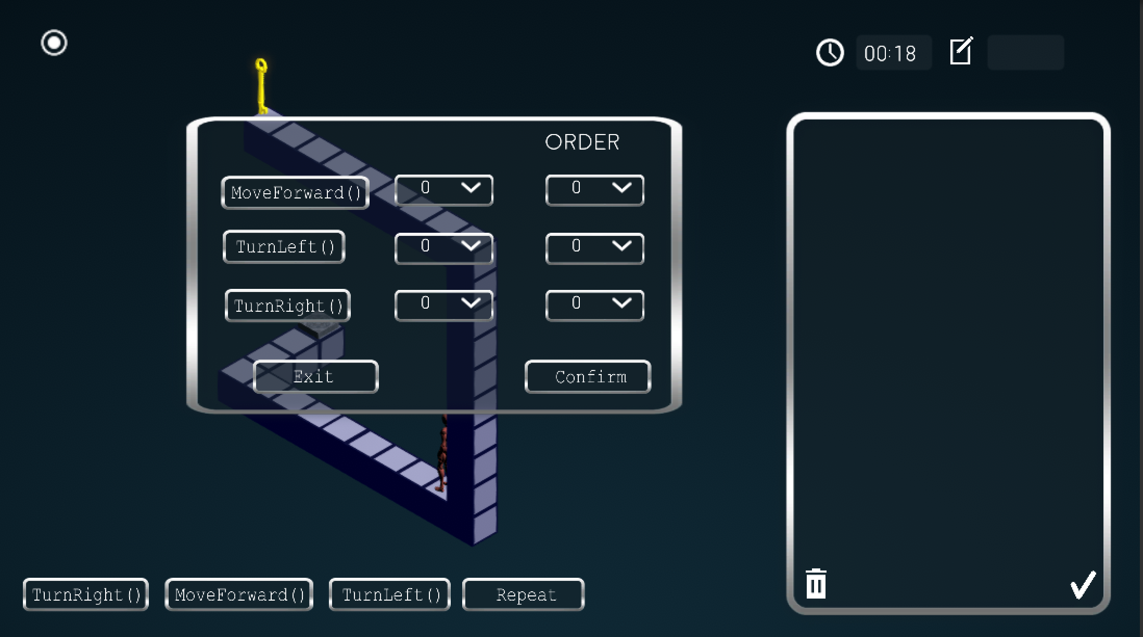
Screenshots
Notes:
10 seconds.
Introduce the problem that the whole project (in all versions) tackles with GIF or screenshot.

Slide 11
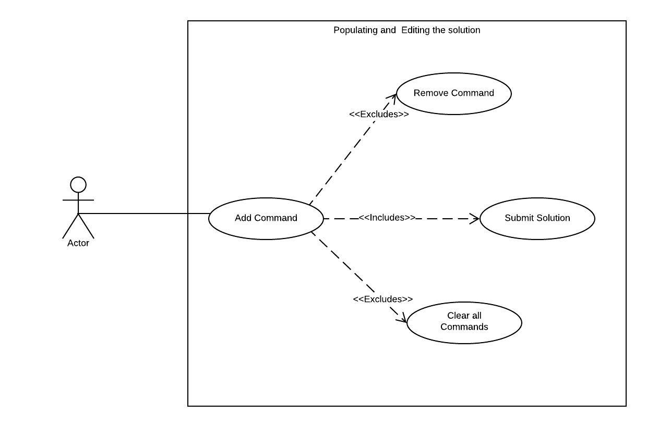
Requirements: Use Cases
Notes:
5 seconds
Show the Use Case Diagram for the whole project. Highlight your use cases.

Slide 12
System Design: Architecture
The system was structured in a MVC architecture. Where the Models are the game objects such as the player, the maze, the solution panel and the controls. The Unity scene that shows the user interface was treated as the View, and lastly, the C# scripts that allowed for communication between the Unity Scene and the backend, was treated as the Controller. This structure separates the business layer, the user interface and the database logic from each other.
Notes:
20 seconds
System design: Highlight the parts that you contributed to them.
1. System decomposition; identify the architecture patterns used
2. System deployment – h/w and s/w requirements

Slide 13
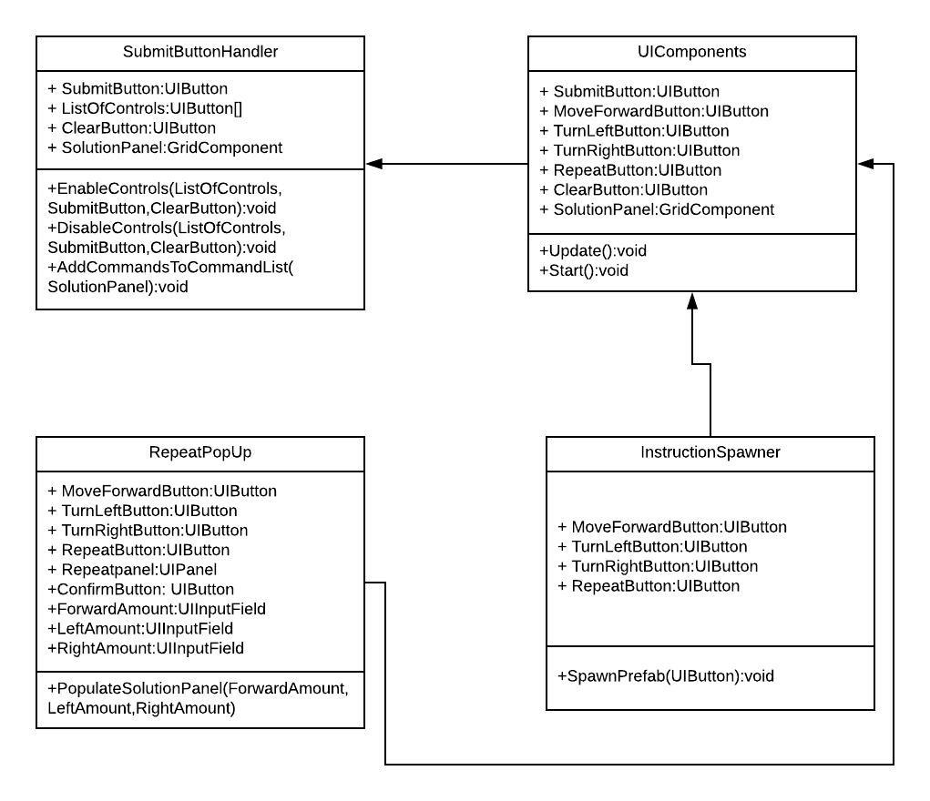
Minimal Class Diagram
Notes:
10 seconds.Minimal class diagram. Highlight the classes that you created/modified
Identify the design patterns used (one or more slides).

Slide 14
User Stories
As a User I would like to easily navigate through the user interface and add instructions to the solution panel so that I can develop a solution to submit later.
As a User I would like to submit my solution by clicking on the submit button so that I can move my character.
As a User I would like to delete instructions from the solution panel so that I can remove those instructions I believe unnecessary.
As a User I would like to have a clear button to remove all instructions at once so that I can empty my slate and begin fresh.
As a User I would like to be walked through the game before starting so that I can get a clear understanding of how to succeed in the game.
As a Developer I would like to disable the submit & clear buttons once the character starts executing commands until it finishes.
As a player I would like to see the time I have been taking for my solution, displayed at the top of the screen.
As a User I would like to click on the repeat button and specify the amount of times I would like a command to be repeated.
Notes:
5 seconds.
List the user stories that you worked on them.(put in order of importance). Stay focused on the parts that you have been working.

Slide 15
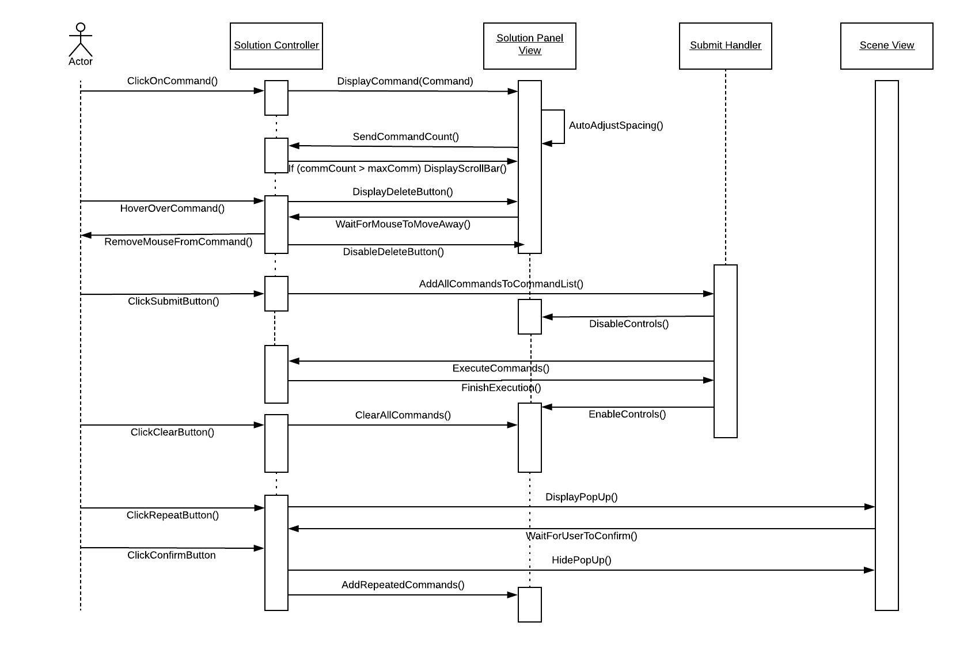
Adding and Editing User Commands
Notes:
60 seconds
The tile of user story
The most important user story you worked on it. You have to describe this one very well and be proud of that.
Please present and show the complexity of your work, code, algorithms, and technical challenges and technologies you have used. (you could use screenshot if you want. Visual presentations are better than text presentation)
Go into the details of the most important/significant tasks using bullet lists or visual graphs or state chart diagram
Sequence Diagram for this user story is mandatory (in another separate page if required)
Demo using screenshots or GIF (in another separate page if required)

Slide 16
Test Suites and Test Cases
Unit Test
Test case ID: 1
Description/Summary of Test: Verify that by clicking a command control, the correct command pops up in the solution panel.
Pre-condition: User clicks a command.
Expected Results: Solution panel shows the same command being added.
Actual Result: Status (Fail/Pass): Passed
Unit Test
Test case ID: 2
Description/Summary of Test: Verify that the delete button shows up when hovering over a command.
Pre-condition: Player hovers over a command.
Expected Results: Delete button shows up
Actual Result: Status (Fail/Pass): Passed
Notes:
10 seconds
A description of verification process and Test Suites and Test Cases for one of the use cases.
1 One sunny day and one rainy day for the implemented use cases (one or more slides).
2 Automated test scripts for the implemented use cases (if any) (one or more slides).

Slide 17
Test Suites and Test Cases
Unit Test
Test case ID: 3
Description/Summary of Test: Verify that the delete button leaves when hovering away from a command.
Pre-condition: Player’s mouse is currently over a command.
Expected Results: The delete button leaves.
Actual Result: Status (Fail/Pass): Passed
Unit Test
Test case ID: 4
Description/Summary of Test: Verify that all commands are deleted upon clicking the trash icon.
Pre-condition: There are commands in the solution panel.
Expected Results: All commands are deleted from the solution panel.
Actual Result: Status (Fail/Pass): Passed
Notes:
10 seconds
A description of verification process and Test Suites and Test Cases for one of the use cases.
1 One sunny day and one rainy day for the implemented use cases (one or more slides).
2 Automated test scripts for the implemented use cases (if any) (one or more slides).

Slide 18
Test Suites and Test Cases
Unit Test
Test case ID: 5
Description/Summary of Test: Verify that the commandList on the backend is cleared when the trash icon is cleared.
Pre-condition: The trash icon has been clicked.
Expected Results: The commandList holding the commands deletes all of its items.
Actual Result: Status (Fail/Pass): Passed
Unit Test
Test case ID: 6
Description/Summary of Test: Verify that the timer is paused when the game starts until the tool tips are finished.
Pre-condition: The player has started playing.
Expected Results: The timer begins after the last tool tip.
Actual Result: Status (Fail/Pass): Passed
Notes:
10 seconds
A description of verification process and Test Suites and Test Cases for one of the use cases.
1 One sunny day and one rainy day for the implemented use cases (one or more slides).
2 Automated test scripts for the implemented use cases (if any) (one or more slides).

Slide 19
Test Suites and Test Cases
Unit Test
Test case ID: 7
Description/Summary of Test: Verify that the commands are added to the commandList on the backend when the user clicks on Submit.
Pre-condition: There are commands in the commandPanel.
Expected Results: The commandList gets populated when the player clicks on submit button.
Actual Result: Status (Fail/Pass): Passed
Unit Test
Test case ID: 8
Description/Summary of Test: Verfiy that a panel with the repeat options pops up upon clicking the repeat button.
Pre-condition: Player clicks on repeat button.
Expected Results: A pop up panel shows up showing the optional commands and an input field to specify the amount of times it can be repeated and the order.
Actual Result: Status (Fail/Pass): Passed
Notes:
10 seconds
A description of verification process and Test Suites and Test Cases for one of the use cases.
1 One sunny day and one rainy day for the implemented use cases (one or more slides).
2 Automated test scripts for the implemented use cases (if any) (one or more slides).

Slide 20
Test Suites and Test Cases
Unit Test
Test case ID: 8
Description/Summary of Test: Verfiy that a panel with the repeat options pops up upon clicking the repeat button.
Pre-condition: Player clicks on repeat button.
Expected Results: A pop up panel shows up showing the optional commands and an input field to specify the amount of times it can be repeated and the order.
Actual Result: Status (Fail/Pass): Passed
Notes:
10 seconds
A description of verification process and Test Suites and Test Cases for one of the use cases.
1 One sunny day and one rainy day for the implemented use cases (one or more slides).
2 Automated test scripts for the implemented use cases (if any) (one or more slides).

Slide 21
Summary
Mairim Barrios
mbarr203@fiu.edu
Notes:
10 seconds
Summarize your contribution, mention your effort for Scrum, Mingle, Github, Google Drive Documentation and minutes
Include your contact information
Ask if anyone has any questions for you.
Thank your audience

